Slide 1
Chapter 1
Strategic Management and Strategic Competitiveness

Slide 2
Learning Objectives
Studying this chapter should provide you with the strategic management knowledge needed to:
Define strategic competitiveness, strategy, competitive advantage, above-average returns, and the strategic management process.
Describe the competitive landscape and explain how globalization and technological changes shape it.
Use the industrial organization (I/O) model to explain how firms can earn above-average returns.
Use the resource-based model to explain how firms can earn above-average returns.
Describe vision and mission and discuss their value.
Define stakeholders and describe their ability to influence organizations.
Describe the work of strategic leaders.
Explain the strategic management process.

Slide 3
Twenty-First Century Competition
Today’s competitive markets
The global economy
Rapid
technological change
Increasing importance of knowledge
and people
Globalization

Slide 4
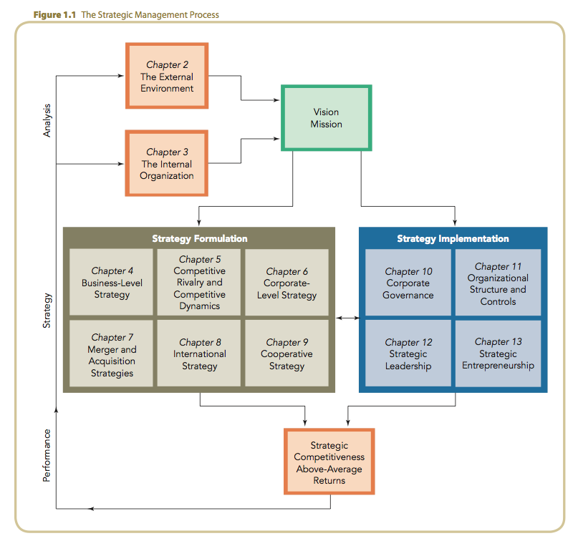
The Strategic Management Process

Slide 5
The Global Competitive Landscape
Increasing
Market volatility and instability due to
the rapid pace of change in markets
Blurring of market boundaries
Globalized flow of financial capital
Need for flexibility, speed, innovation,
and integration in the use of technology
Strategic and operational complexity
of global-scale competition
Rising product quality standards
Decreasing
Traditional time for adapting to change
Traditional sources of competitive advantage
Traditional managerial mindset

Slide 6
Hypercompetition
Strategic options in hypercompetitive environments
Global economy
Technology
Use of
price-quality positioning to build market presence
Creation of new know-how and
use of first-mover advantage
Protection or invasion of established geographic or product markets

Slide 7
Competitive Success Factors
Top corporate performers
Have an entrepreneurial/
opportunistic mindset
Make effective
use of valuable competencies
Offer new
and innovative products and services
Are market/ customer-needs oriented

Slide 8
Technology and Technological Changes
Increasing rate of technology diffusion and the emergence
of disruptive technologies
Technology trends impacting the global competitive environment
The information age: Internet and the global proliferation of low-cost computing power
Increasing knowledge intensity
as an intangible source of competitive advantage

Slide 9
Strategic Choices
The firm’s strategic choices
Economies
of scale
Barriers to market entry
Diversification
Product differentiation
Industry concentration
Market
frictions

Slide 10
Five Forces Model of Competition
Substitutes
Suppliers
Industry rivalry
Buyers
Potential entrants

Slide 11
Five Forces Model Assumptions
Industry profitability (i.e., rate of return on invested capital relative to cost of capital) is a function of interactions among the five forces.
Industry attractiveness equates to its profitability potential for earning above-average returns by:
  producing standardized goods or services at costs below competitor costs (a cost leadership strategy).
  producing differentiated goods or services for which customers are willing to pay a price premium (a differentiation strategy).

Slide 12
The Resource-Based Model of Above-Average Returns
Building competitive advantage
Core
competence
A source of competitive advantage
Capability
An integrated set of resources
Resources
Physical, human, and organizational capital
(tangible and intangible)

Slide 13
Strategic Decision Making
Industry organization (I/O) model
Resource-based
model
Competitive strategy
decision

Slide 14
Vision Statement
A Successful Vision:
  is an enduring word picture of what the firm wants to be and expects to achieve in the future.
  stretches and challenges its people.
  reflects the firm’s values and aspirations.
  is most effective when its development includes all stakeholders.
  recognizes the firm’s internal and external competitive environments.
  is supported by upper management decisions and actions.

Slide 15
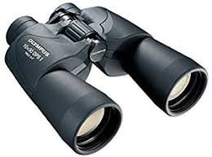
VIDEO
The Power of Vision

Slide 16
Mission Statement
An Effective Mission:
  specifies the present business or businesses in which the firm intends to compete and customers it intends to serve.
  has a more concrete, near-term focus on current product markets and customers than the firm’s vision.
  should be inspiring and relevant to all stakeholders.

Slide 17
Classification of Stakeholders
Categories of stakeholders
Capital market stakeholders
Product market stakeholders
Organizational stakeholders

Slide 18
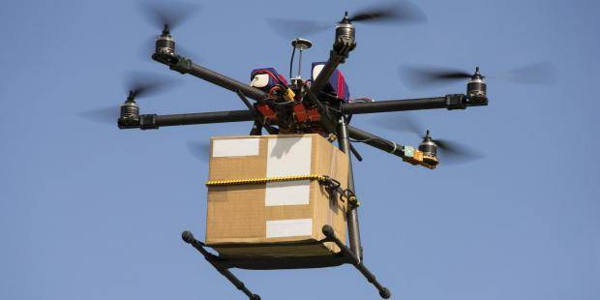
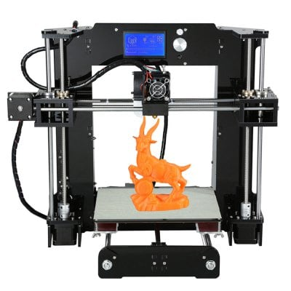

Group Activity
Identify one new technology in next 10 Yrs
How will it affect people in the future
Give an example of how it would work
What are the benefits of new technology

